Slide 1
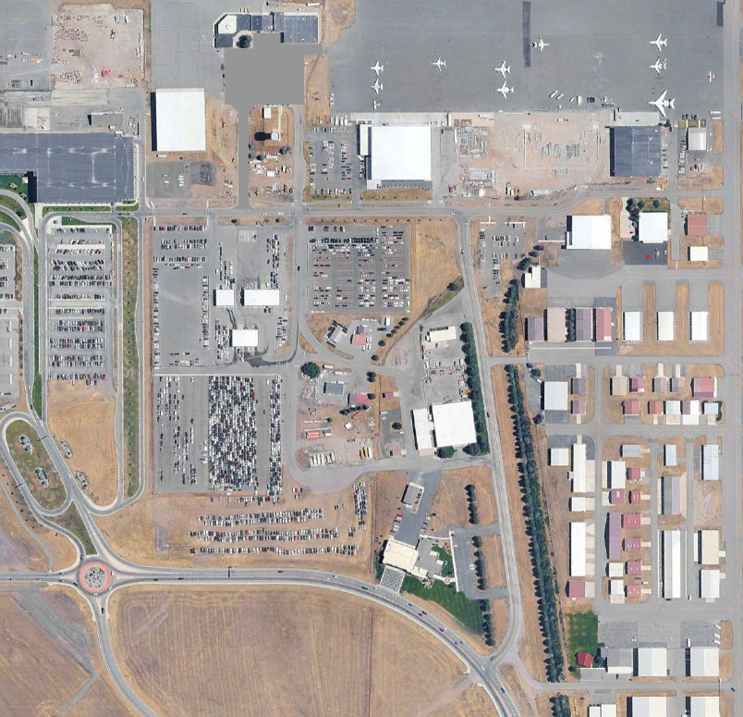
662 WINGS WAY
AIR TRAFFIC CONTROL TOWER
PARKING
PARKING
WINGS WAY
WINGS WAY
AIRPORT BLVD

